Slide 1
Item 8.4(4) – Demonstration of WIPPS Rolling Review of Requirements
Third Session of the Infrastructure Commission
(INFCOM-3, 15-19 April 2024)
David RICHARDSON / Chair SC-ESMP
17 April 2024

Slide 2
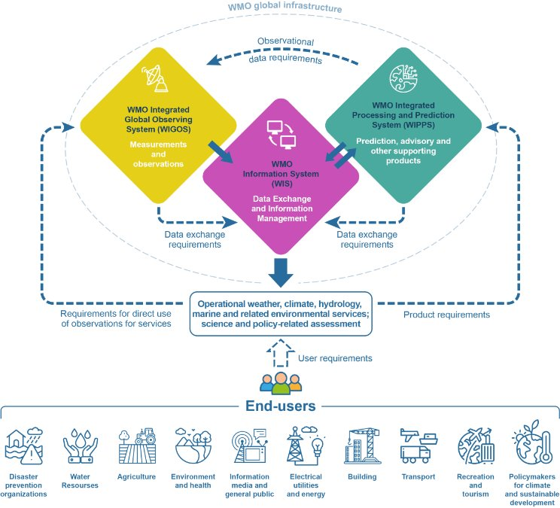
Doc 8.4(4) Draft Decision: Demonstration of WIPPS Rolling Review of Requirements
The purpose is to provide a systematic and transparent process to support the high-level design and evolution of WIPPS.
The RRR process compiles information on Members’ evolving requirements on analyses and predictions.
Demonstration till INFCOM-4
Collaborate with SERCOM
Test and elaborate the process
Propose the final process to INFCOM-4
See more detail - INF 8.4(4) WIPPS Rolling Review of Requirements
WIPPS RRR

Slide 3
Doc 8.4(4) Draft Decision: Demonstration of WIPPS Rolling Review of Requirements
STEP 1
Review of
User Requirements
for analyses
and predictions
by Requirement Owner
in consultation with
user community
STEP 2
Gap Analysis
by SC-ESMP
in consultation with Requirement Owner
STEP 3
Statements of Guidance (SoG)
by SC-ESMP
STEP 4
High-level Guidance for Evolution of WIPPS
by INFCOM
Update
User Requirement Database
Develop
Gap Analysis Report
Develop
Statements of Guidance
Develop High-level Guidance

Slide 4
Thank you.
^{wmo.int}

